Slide 1
Self Introduction About Me
This is SUMAN SINGH .

Slide 2
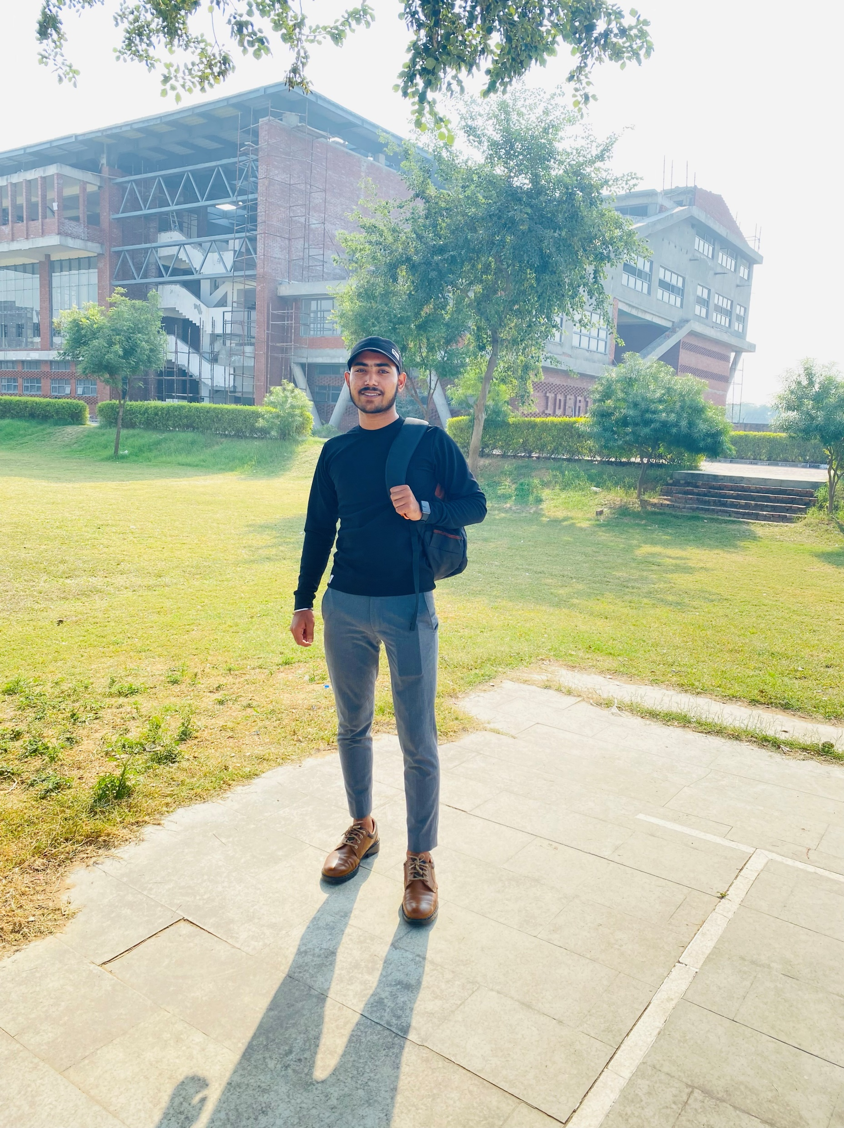
Suman Singh
Hello Every One,
This is Suman Singh
From- GAYA (BIHAR)

Slide 3
Educational Qualification
Schooling is from - Subhash International School, GAYA
Intermediate from- Kendriya Vidyalaya No.2 In ARMY (OTA Campus), GAYA.
Graduation is from- (PURSUING)

Slide 4
FAMILY BACKGROUND
FATHER’S NAME :- RAMADHIR SINGH
HE IS iN INDIAN ARMY (RANK- SUBEDAR MAJOR)
(UNIT- 15 RAJPUT REGIMENT)
MOTHER’S NAME :– MANJU SINGH
SHE IS A HOUSEmaker
BROTHER’S NAME :- SHEKHAR SINGH
HE IS A STUDENT OF LLB (LEGUM BACCALAURES)

Slide 5
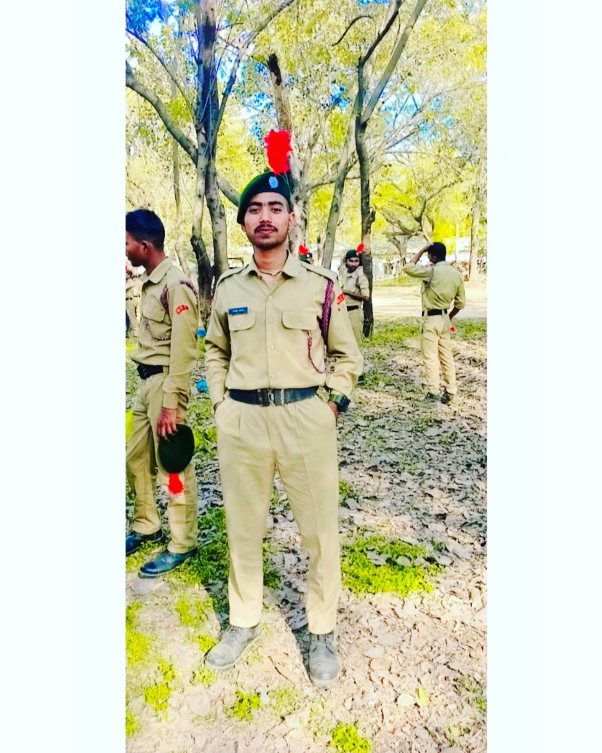
Extra curriculums ncc regiment no. 6br|20|sda|214702

Slide 6
achievements
Received award of appreciation from Commanding Officer.
Certificate of participation from NCC.

Slide 7
SPECIAL INTERESTS
READING BOOKS
HAVING FUN WITH FRIENDS
LISTENING MUSIC
COOKING
ART
CODING

Slide 8
PRESENTATION
Welcome to MY PRESENTATION

Slide 9
THANK
YOU!!!!

